Slide 1

Maren Rieker & Kabir Sandrolini
Notes:
tsibble comes from time-series + tibble
The ‘ts’ pronounced as in ‘cats’

Slide 2
Outline
Brief history of tsibble
Quick recap of time series data
Basic structure and usage
Working with tsibble
The Tidyverts ecosystem and other related packages

Slide 3
Intro to tsibble
tsibble first emerged around 4 years ago
Built on top of tibble, tsibble extends the tidyverse to temporal-context data, creating a new data infrastructure for time series data
Main improvements over previous approaches:
Time is an explicitly declared variable rather than an implicit attribute
Allows for heterogeneous data structures, implicit missing values, multiple variables, and more
Handles irregularly spaced time series well
Adheres to tidyverse logic: it is data-centric rather than model-centric, and is designed for a human readable pipeline
Notes:
Created by Earo Wang: a statistician and data scientist currently at the University of Auckland. Additional contributions came from Dianne Cook, Rob J Hyndman, and Mitchell O’Hara - Wild. It started as a data structure and then became a package, with tools for wrangling and modeling
Compared to the conventional time series objects in R (for example the R native ts, zoo, and xts) tsibble preserves time indices as the essential data column, and makes heterogeneous data structures possible. It is much easier to work with than its predecessors.
The previous convention for time series was a matrix, which did not easily accommodate complications such as multiple variables, heterogeneous data types, implicit missing values, and so on. tsibble also accounts for irregularly spaced time series. Previous approaches were model-centric rather than data-centric, making it hard to adjust the data.
The 'tsibble' provides tools to easily manipulate and analyse temporal data, such as filling in time gaps and aggregating over calendar periods.
Tsibble adds time indices for weeks, quarters, and months.

Slide 4
Time series data
A collection of observations obtained from repeated measurements over time
Useful for identifying trends, cycles, and seasonal variances
Time series data can be:
Regular: measurements obtained at a constant time interval
Irregular: measurements obtained at inconsistent time intervals (‘event data’)
Notes:
This first point may seem obvious, but it is useful to keep in mind. There is a natural chronological order, and you are observing change over time
Give examples of regular vs irregular
Previous R structures were not very good at accounting for irregular time series data

Slide 5
Basic structure
Each observation should be uniquely identified by a key and an index
Key corresponds to a set of variables that uniquely identify observational units over time, by referencing the index timestamps.
It can consist of empty, one, or more variables, meaning you can nest and cross variables.
Index contains time indices. tsibble will default to regularly spaced intervals (for irregular data you must specify otherwise).
tsibbles are sorted by keys, and then by index chronologically.
Notes:
Keys can be subjects or individuals. Nesting means that one variable implies another one (eg ‘country’ will be nested within ‘continent’), while crossing means you choose multiple variables to be keys.
Index has inherent chronological ordering. Each observational unit should be measured at a common interval, if regularly spaced.
tsibble will recognize different time frequencies. It has time class functions for frequencies (including year, quarter, month, week, day, all the way to nano-seconds).

Slide 6
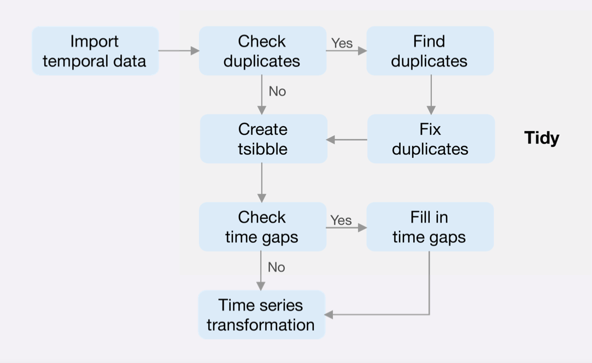
Working with tsibble

Slide 7
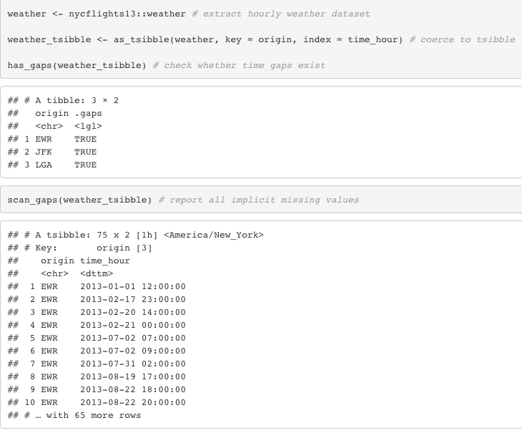

Slide 8
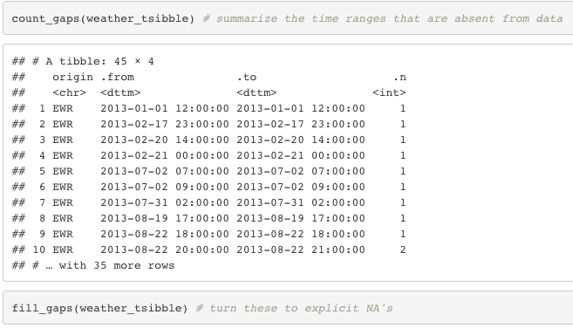
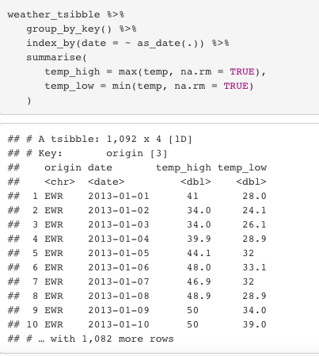

Slide 9
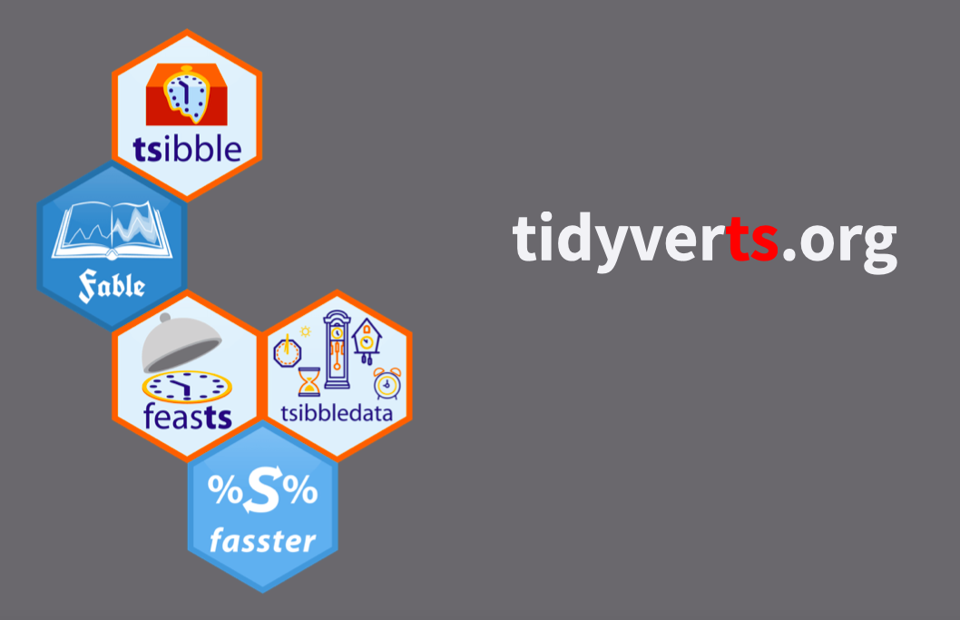
Tidyverts & other packages
The tidyverts ecosystem is built around the tsibble object for tidy time series analysis
feasts - visualizing data and extracting time series features
Fable: a collection of commonly used univariate and multivariate time series forecasting models
tsibbledata - a range of tsibble dataset examples
Notes:
Fable is very useful in conjunction with tsibble. Its models include ETS, exponential smoothing via state space models and automatic ARIMA modelling. It provides a tidy forecasting framework built on top of tsibble, with the goal of promoting transparent and human-centered forecasting practices.
More links in GitHub readme

Slide 10
References
tidyverts/tsibble: Tidy Temporal Data Frames and Tools. Retrieved 30 October 2021, from https://github.com/tidyverts/tsibble
tsibble: Tidy data structures to support exploration and modeling of temporal-context data. (2018). Retrieved 30 October 2021, from https://www.youtube.com/watch?v=v6yRmbulxUM
Wang, E. (2019). Reintroducing tsibble: data tools that melt the clock. Retrieved 30 October 2021, from https://blog.earo.me/2018/12/20/reintro-tsibble/
Wang, E., Cook, D., Hyndman, R., & O'Hara-Wild, M. (2021). Tsibble documentation. Retrieved 30 October 2021, from https://cran.r-project.org/web/packages/tsibble/tsibble.pdf
Wang, E. Introduction to tsibble. Retrieved 30 October 2021, from https://mran.microsoft.com/snapshot/2018-01-26/web/packages/tsibble/vignettes/intro-tsibble.html
Wang, E. Introduction to tsibble. Retrieved 30 October 2021, from https://cran.rstudio.com/web/packages/tsibble/vignettes/intro-tsibble.html
What is time series data?. Retrieved 30 October 2021, from https://www.influxdata.com/what-is-time-series-data/
Wang, E., Cook, D., & Hyndman, R. J. (2020). A new tidy data structure to support exploration and modeling of temporal data. Journal of Computational and Graphical Statistics, 29(3), 466-478.

